Slide 1
BRAIN TUMOR MULTICLASS CLASSIFICATION
A NEW ERA OF HOPE

Slide 2
GROUP MEMBERS :
01
REZUAN ISLAM SAMIR
02
SHADMAN SHAKIB DIP
ID : 2021092642
ID : 2111882642

Slide 3
Table of content:
01
Introduction
02
Recent Contribution
04
03
Model Architecture
Methodology
06
05
Output
Dataset
07
Conclusion

Slide 4
Introduction
In Bangladesh, the incidence of brain tumors has been increasing over the years. Factors such as population growth, improved healthcare facilities, and increased awareness contribute to the identification and reporting of more case. The diagnosis and management of brain tumors in Bangladesh face multiple challenges. These include a shortage of neurosurgeons, limited availability of advanced imaging techniques, and inadequate facilities for radiation therapy and chemotherapy. As a result, patients often face delays in diagnosis, limited treatment options, and compromised access to specialized care.

Slide 5
Motivation
Accurate Diagnosis
Research and Clinical Trials
Automation and Efficiency

Slide 6
Types of tumor classes that we worked on :
Glioma
Meningioma
Pituitary
No tumor

Slide 7
Recent Contribution
Public awarness has been raised as people is advancing towards modern time. Scientists are now more concern about public health. Here are some latest reasearch work base on Brain Tumor Multi-Class Classification.
"Deep Learning-Based Classification of Brain Tumors Using Magnetic Resonance Imaging" by Kamnitsas et al. (2017)
"Multi-Class Brain Tumor Classification Using Transfer Learning" by Bhandary et al. (2020):

Slide 8
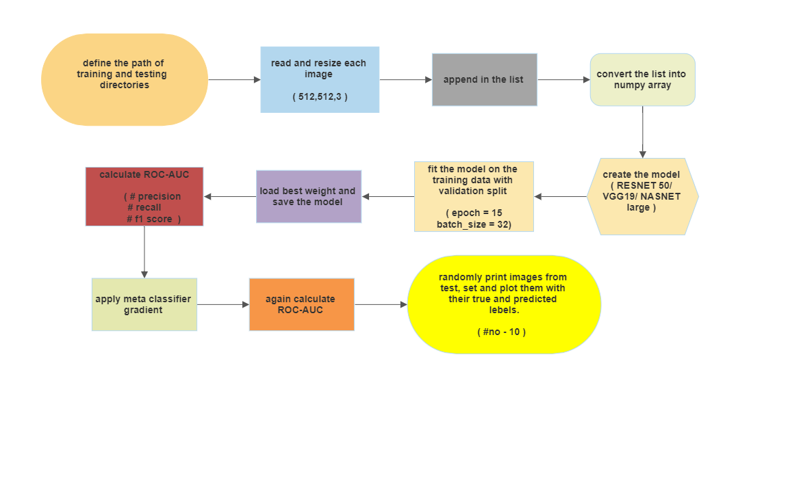
Methodology

Slide 9
Data Set Feature
Our Total Data Set has been split into two folder-
1. Training
2. Testing
Each folders has 4 individual subfolder.
Training folder uphold the 0.8 of total data
Testing folder uphold the 0.2 of total data.

Slide 10
Dataset Table
 | Glioma (training,testing) | Meningioma (training,testing) | Pituitary (training,testing) | No tumor (training,testing)
Dataset 1 | (826,100) | (822,115) | (827,74) | (395,105)
Dataset 2 | (1321,400) | (1339,306) | (1457,300) | (1595,405)
Combined Dataset | (1501,400) | (1500,400) | (1501,374) | (1595,405)
Combined Dataset 2 | (826,159) | (361,171) | (965, 181) | (915, 150)

Slide 11
Classifier Model Architecture
In this Project we use 3 different Classifier Model
RESNET50
VGG19
NASNetLarge
Each Have their own architecture

Slide 12
Training and Evaluation

Slide 13
We first get ready our models using RESNET50, VGG19
and NASNetLarge Classifier Model. Then We use the
model to fit our train data and validation data.

Slide 14
Set Epoch=15, To iterate over 15 times.
Batch_Size = 32, sufficient large.
Plot Epoch vs Training and Validation Accuracy/Loss

Slide 15
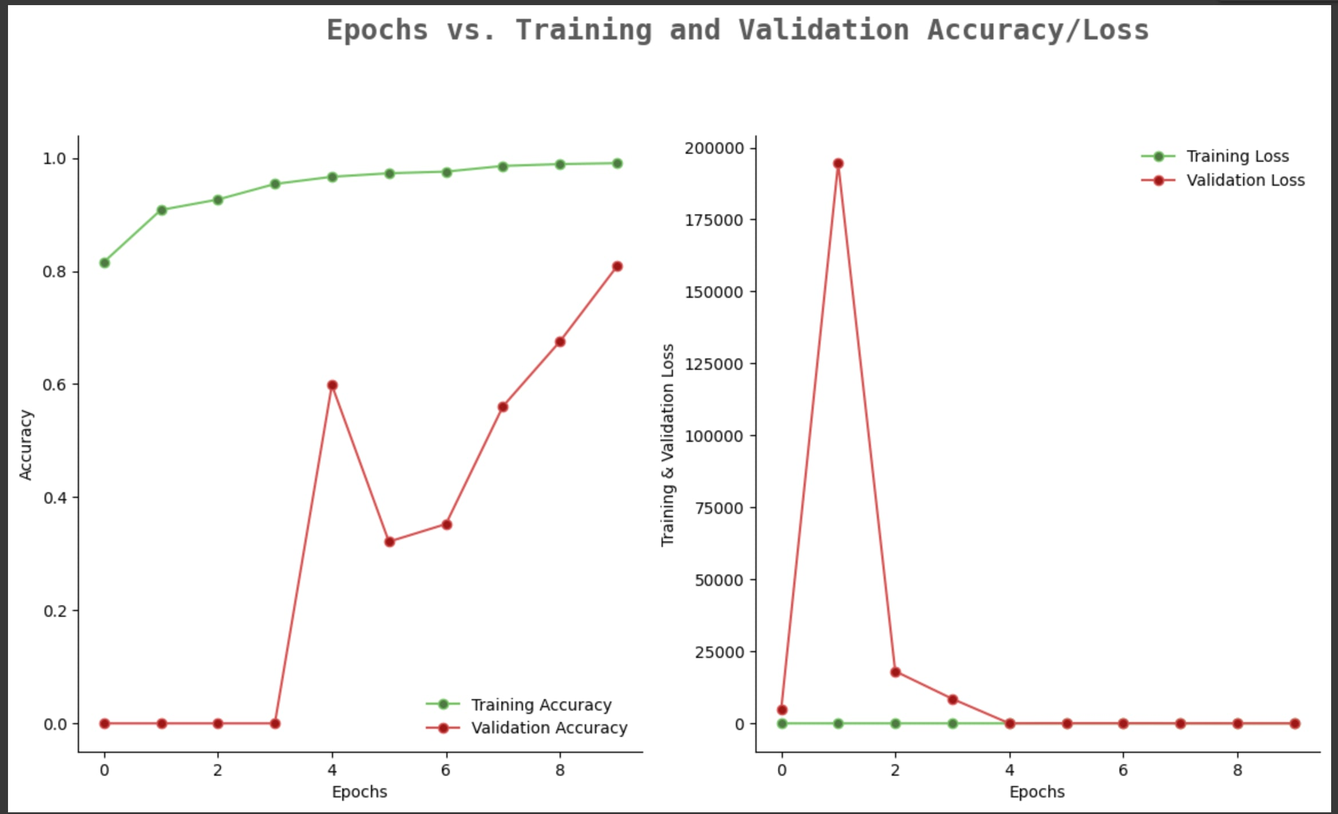
NasnetLarge

Slide 16
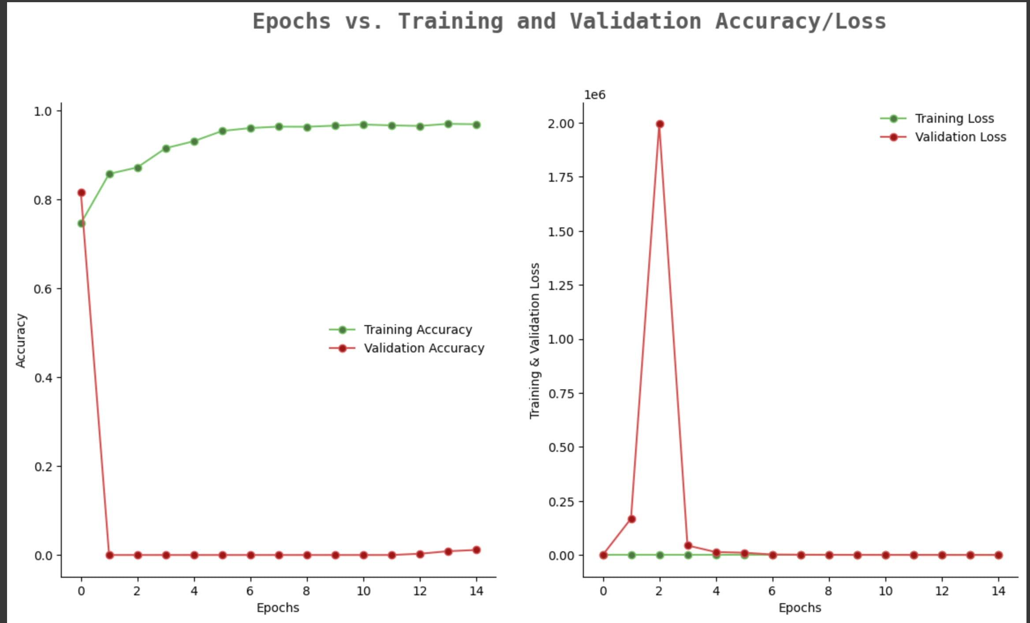
NasnetLarge d2wd1

Slide 17
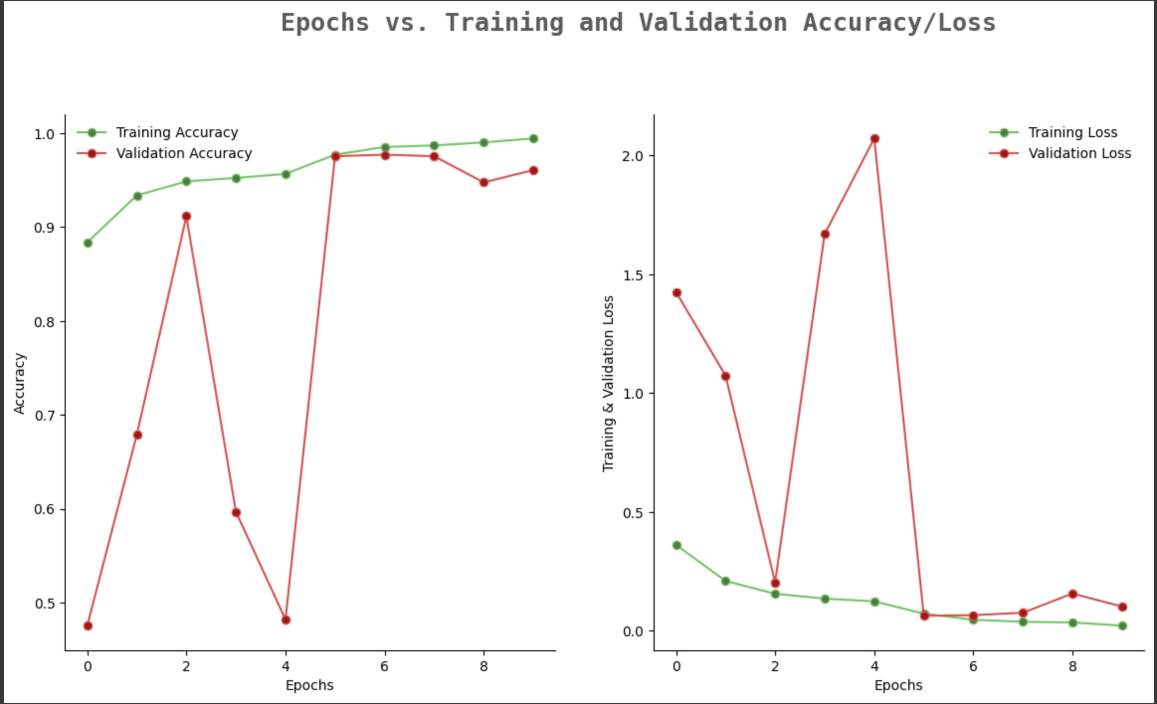
Resnet50

Slide 18
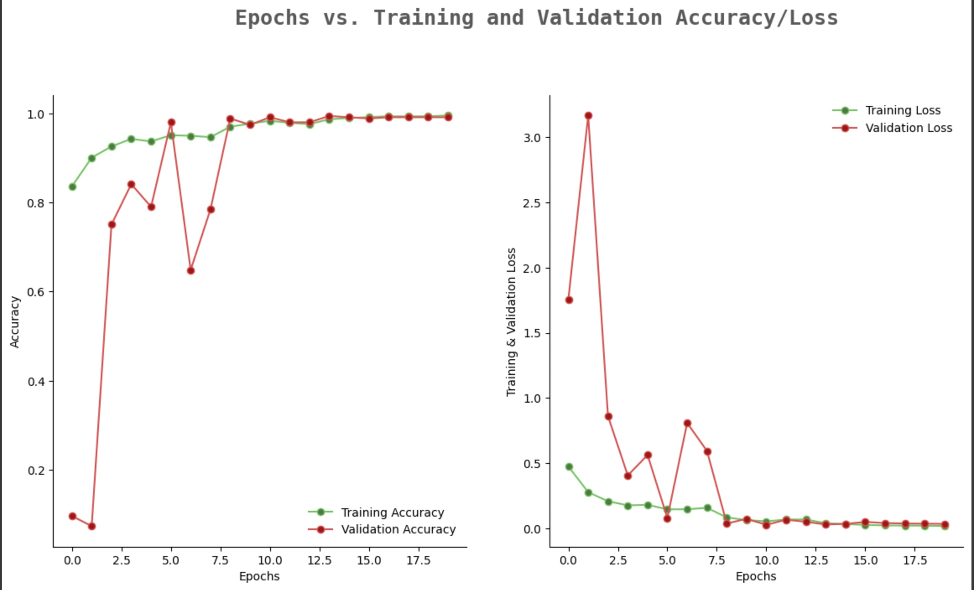
Resnet50 d2wd1

Slide 19
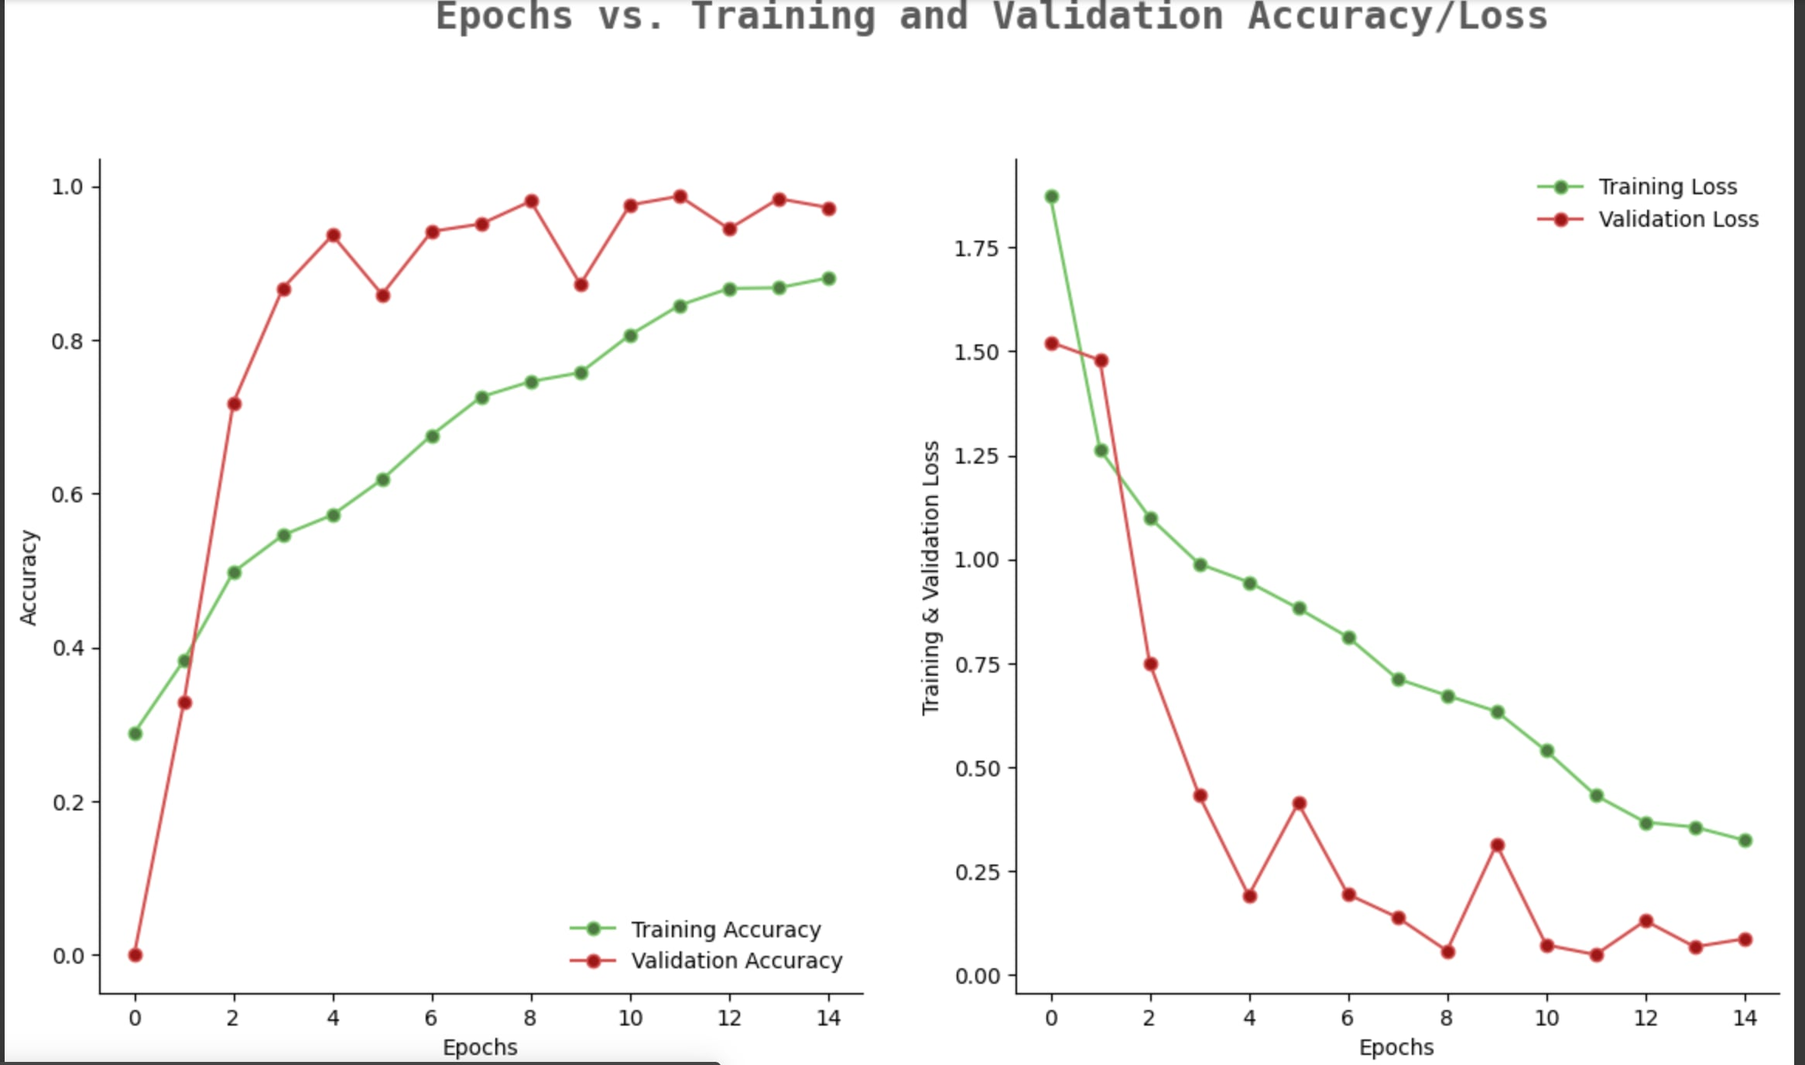
Vgg-19

Slide 20
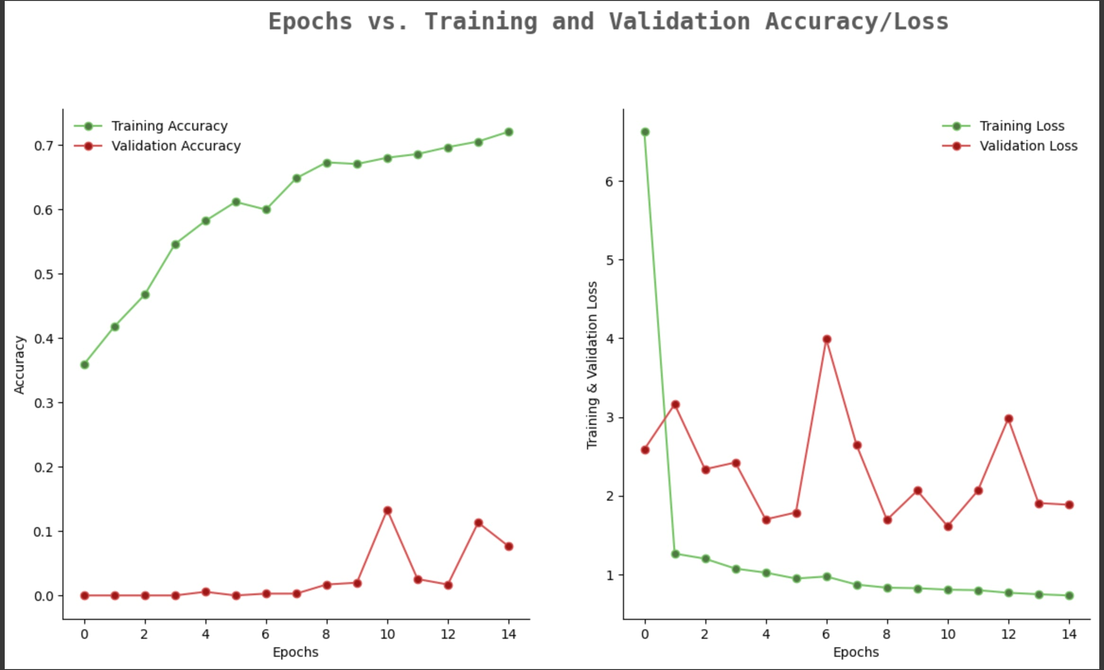
VGG-19 d2wd1

Slide 21
EVALUATION TABLE
Before Meta Classifier:
 | Precision | F1 Score | ROC-AUC | Accuracy
RESNET50 | 0.79 | 0.59 | 0.870 | 0.91
VGG19 | 0.75 | 0.71 | 0.892 | 0.63
NasNetLarge | 0.52 | 0.53 | 0.874 | 0.54

Slide 22
After Meta
Classifier:
 | Precision | F1 Score | ROC-AUC | Accuracy
RESNET50 | 0.86 | 0.83 | 0.952 | 0.92
VGG19 | 0.77 | 0.75 | 0.919 | 0.74
NasNetLarge | 0.52 | 0.53 | 0.874 | 0.68

Slide 23
Ev. Table: D2wD1
Before Meta Class:
 | Precision | F1 Score | ROC-AUC | Accuracy
RESNET50 | 0.97 | 0.94 | 0.963 | 0.86
VGG19 | 0.53 | 0.53 | 0.695 | 0.38
NasNetLarge | 0.27 | 0.41 | 0.476 | 0.23

Slide 24
After meta class:
 | Precision | F1 Score | ROC-AUC | Accuracy
RESNET50 | 0.99 | 0.97 | 0.957 | 0.88
VGG19 | 0.65 | 0.66 | 0.803 | 0.58
NasNetLarge | 0.40 | 0.37 | 0.476 | 0.22

Slide 25
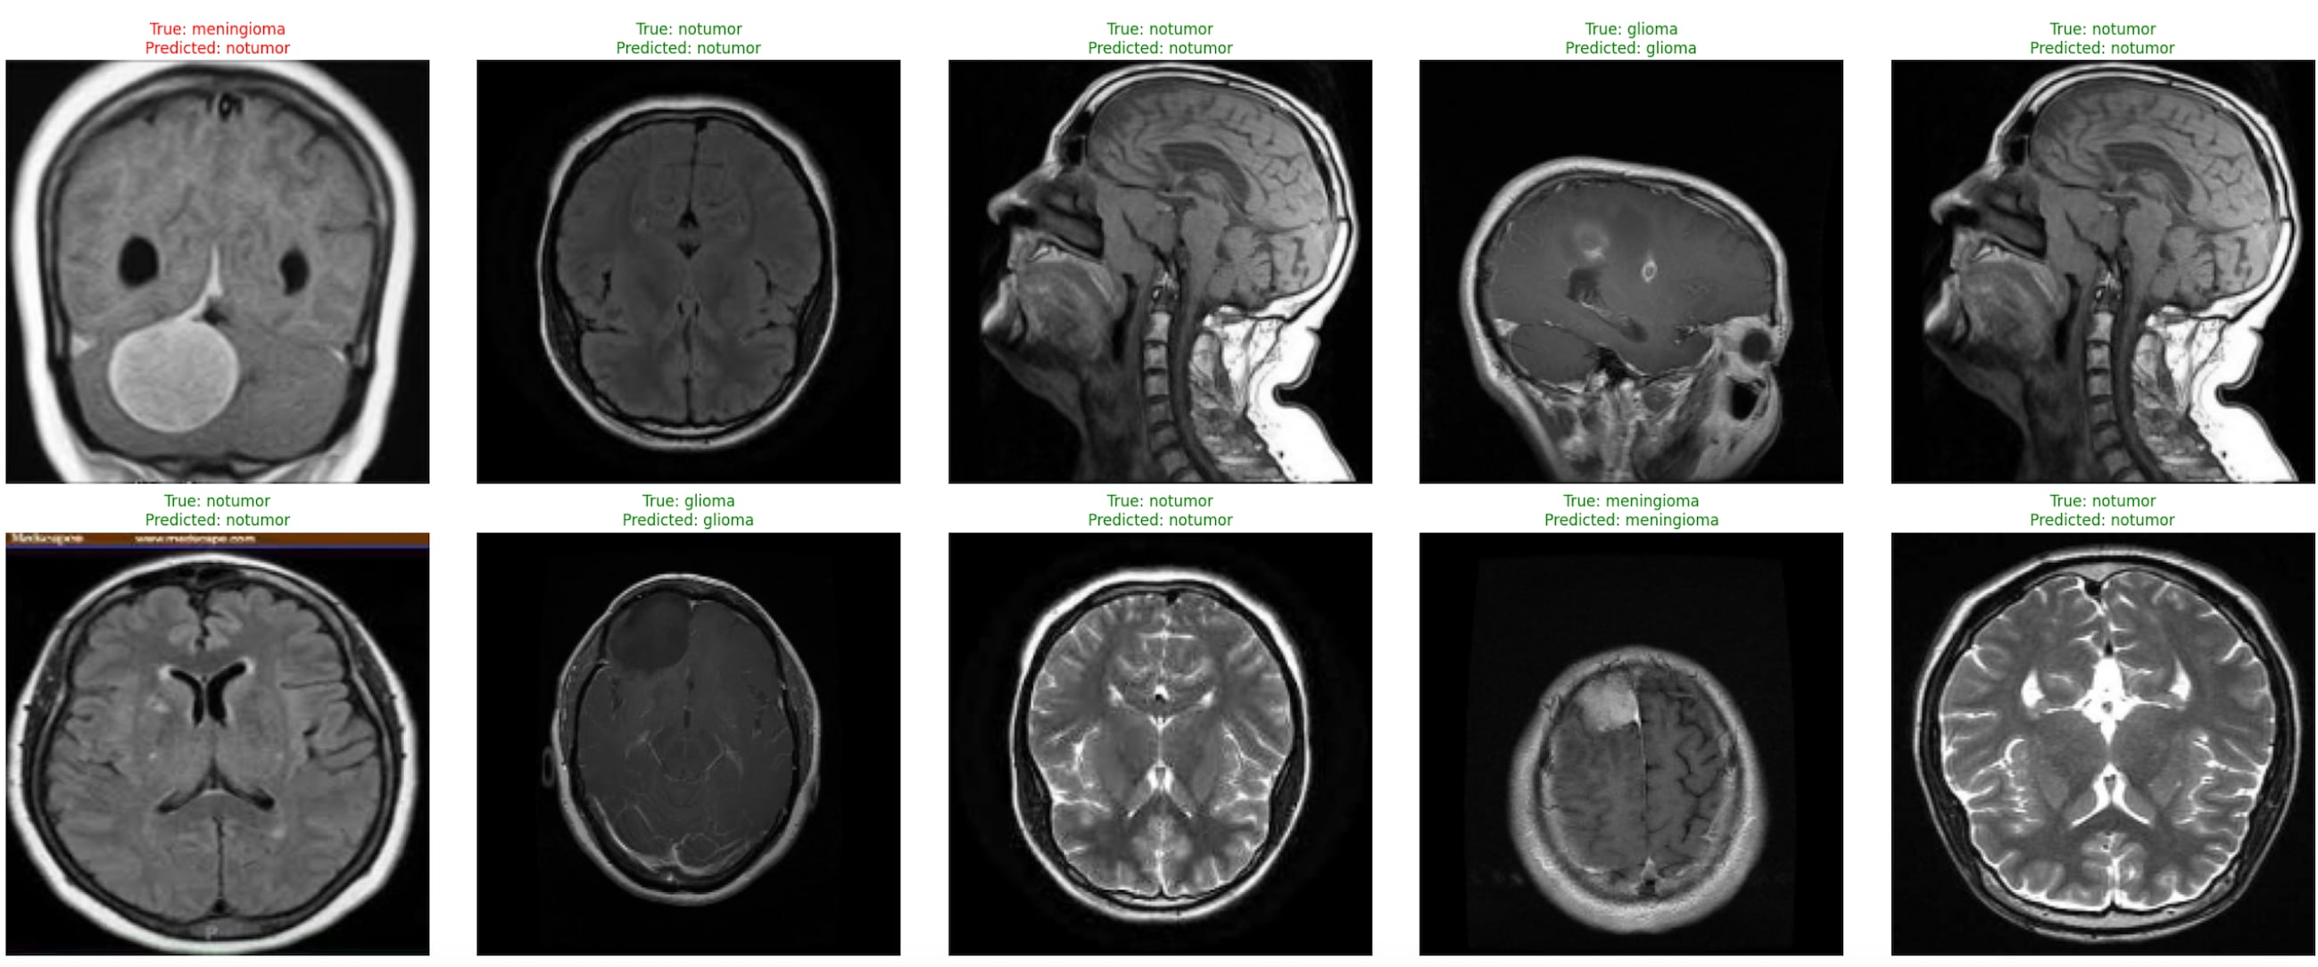
Output

Slide 26
Conclusion
For both merged dataset (d1wd2) & (d2wd1): We can see all the results of merged dataset (d2wd1) is poorer than (d1wd2) hence, we stick with the 1st merged dataset. Before meta classifier the accuracy of Resnet50 is 0.91 which is way more higher than Vgg-19 and NasnetLarge. Moreover,after using meta classifier the accuracy of all the architectural model boosted where we got the maximum accuracy of 0.92 in Resnet50. So,Resnet50 is our best option.

Slide 27
References
A framework for brain tumor detection based on segmentation and features fusion using MRI images- Almetwally Mohamad Mostafa, Mohammed A. El-Meligy
MRI brain tumor detection and classification using parallel deep convolutional neural networks- Takowa Rahman, Md Saiful Islam

